Slide 1
What is Data Warehouse?

Slide 2
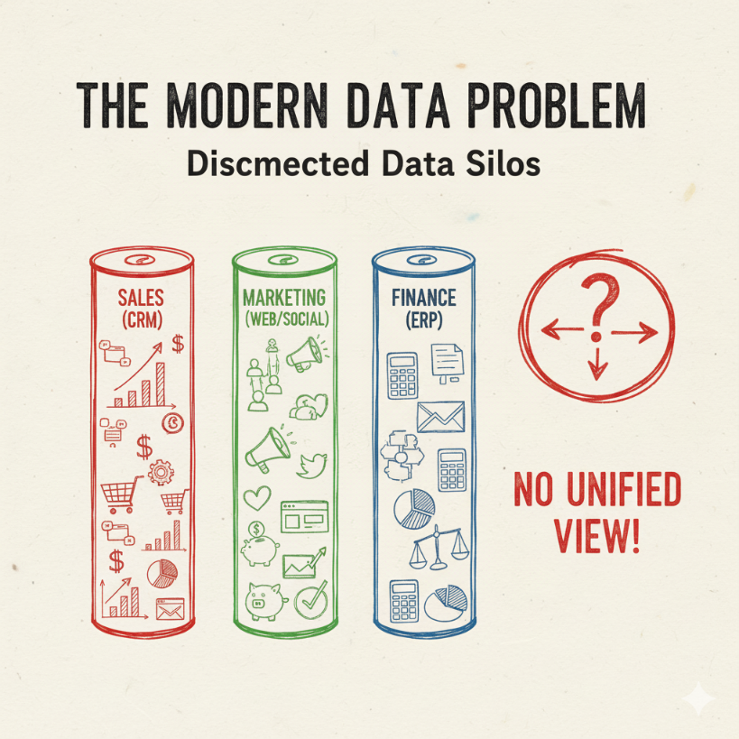
The Modern Data Problem
Organizations collect massive amounts of data every day.
This data is "siloed"—trapped in different, disconnected systems:
Sales data (CRM)
Financial data (ERP)
Marketing data (Web Analytics)
Application logs, IoT devices, etc.
The Challenge: It's impossible to get a complete, unified picture to answer complex business questions.

Slide 3
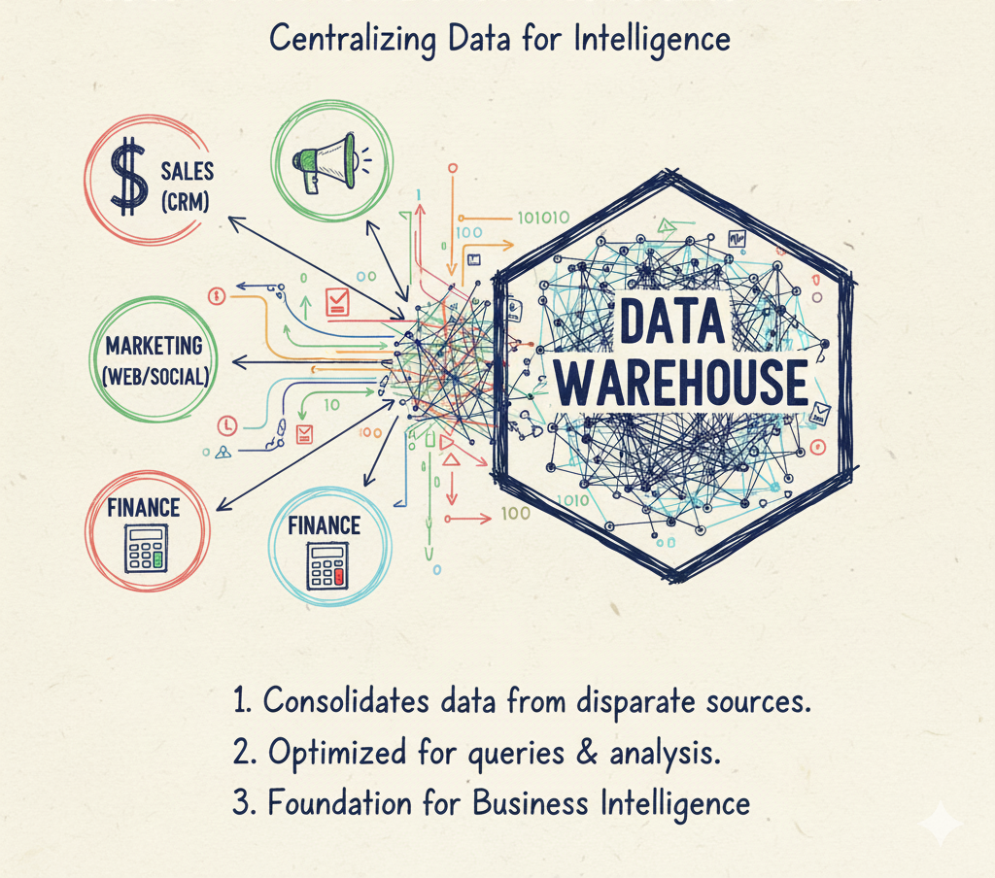
What is a Data Warehouse?
A Data Warehouse (DW) is a large, central data management system.
It is specifically designed to support Business Intelligence (BI) activities, especially analytics.
It centralizes and consolidates large amounts of data from multiple, disparate sources.
It's built for queries and analysis, not for daily transactions (OLAP vs. OLTP).

Slide 4
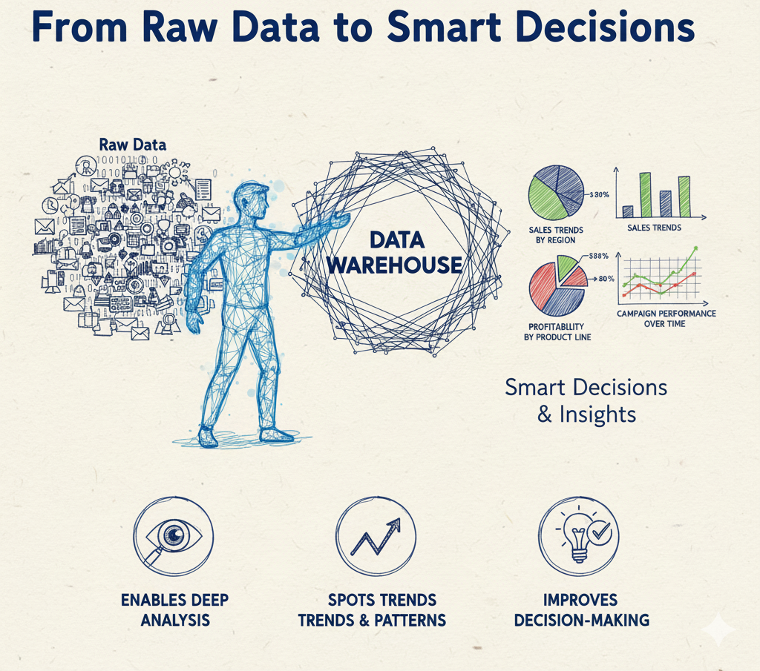
The Core Purpose
From Raw Data to Smart Decisions
Store Historical Data: A DW acts as a "time machine," storing data from months, years, or even decades.
Enable Deep Analysis: This historical record allows you to perform complex queries, spot trends, and find patterns.
Improve Decision-Making: The ultimate goal is to provide clean, reliable data to drive strategy.

Slide 5
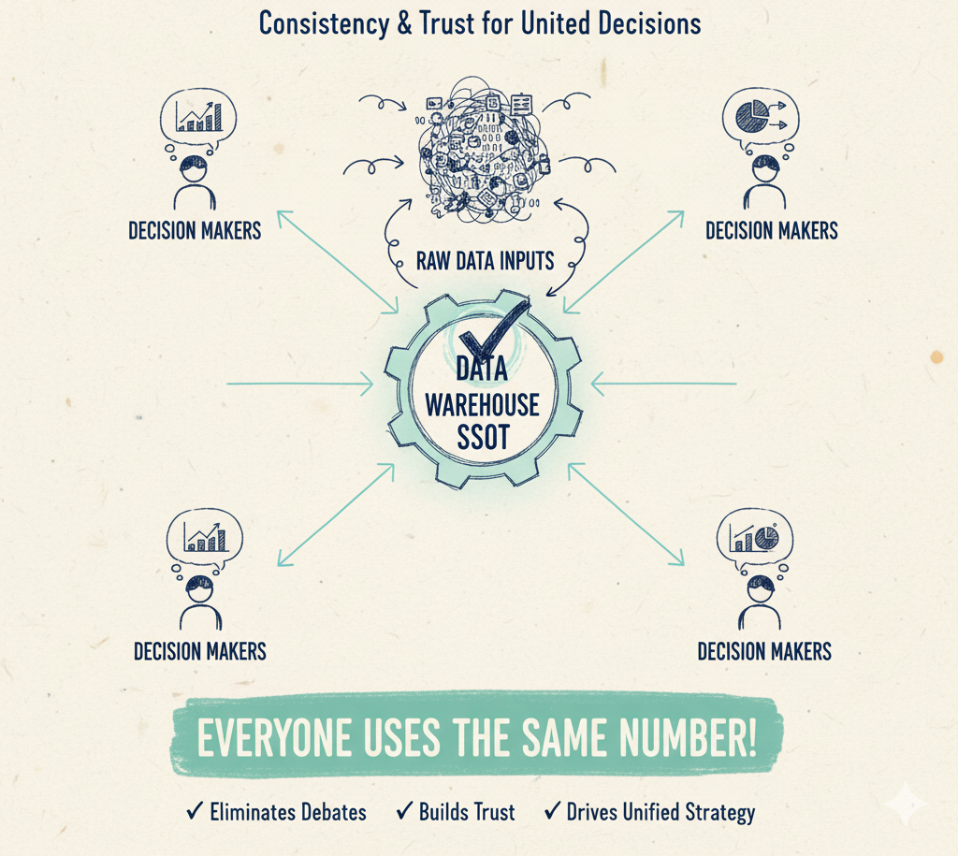
SSOT
The "Single Source of Truth" (SSOT)
This is the most critical concept of a data warehouse.
All data is centralized, cleaned, and standardized.
It becomes the one, official, trusted source for all analytical data.
Benefit: It ends debates. When marketing and finance pull "quarterly sales," they get the same number, building trust and consistency.

Slide 6
Key Takeaways
Centralized System
Solves the "data silo" problem by consolidating data from all business systems (CRM, ERP, etc.) into one place.
Built for Analysis (OLAP)
Optimized for complex queries and reporting (reading data).
This is different from operational systems (OLTP) which handle daily transactions (writing data).
Stores Historical Data
Keeps a long-term record (months, years, decades) to analyze trends and compare performance over time.
Creates a "Single Source of Truth" (SSOT)
Provides one, trusted, and consistent set of data for the entire organization, eliminating debates over "whose numbers are right."

Slide 7
Characteristics of a Data Warehouse

Slide 8
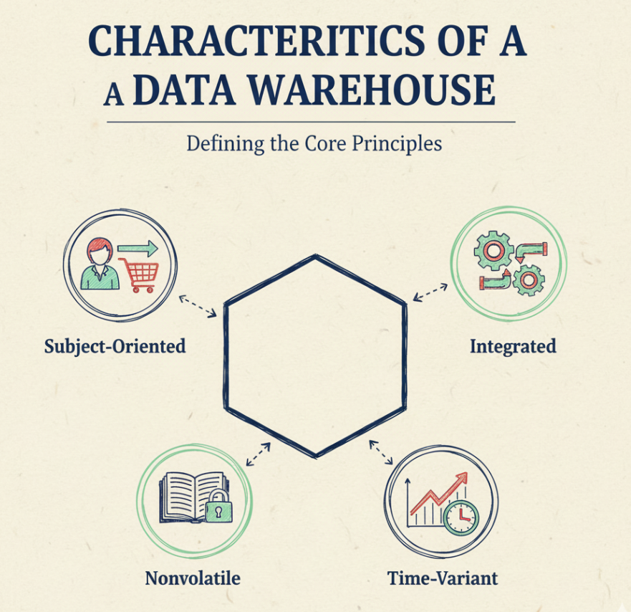
Characteristics of a Data Warehouse
The Four Pillars That Define a DW
Understanding why a data warehouse is different from a regular database.
Based on the principles defined by William Inmon, the “father of the data warehouse”.
We will explore these four core concepts:
Subject-Oriented
Integrated
Nonvolatile
Time-Variant

Slide 9
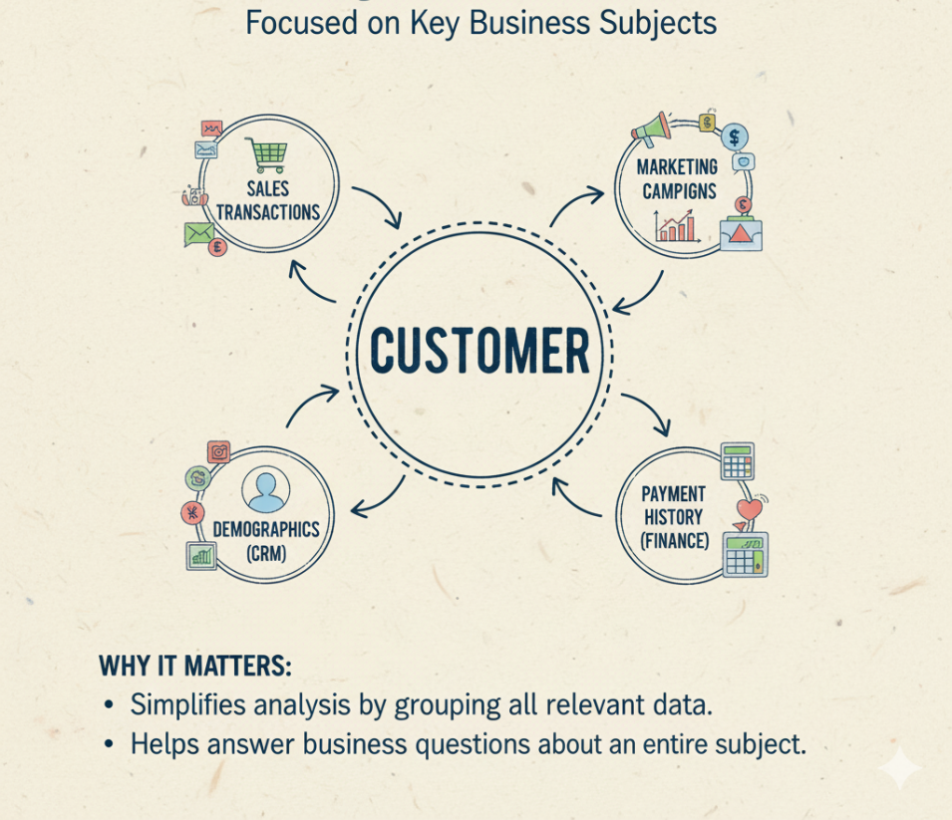
Characteristic 1: Subject-Oriented
Subject-Oriented
Focuses on key business subjects (like Customers, Products, Sales) instead of day-to-day operations (like individual transactions).
Examples of Subjects:
Customers
Products
Sales
Finance
Why it Matters: Simplifies analysis by grouping all relevant data for a specific subject, making it easier to answer high-level business questions.

Slide 10
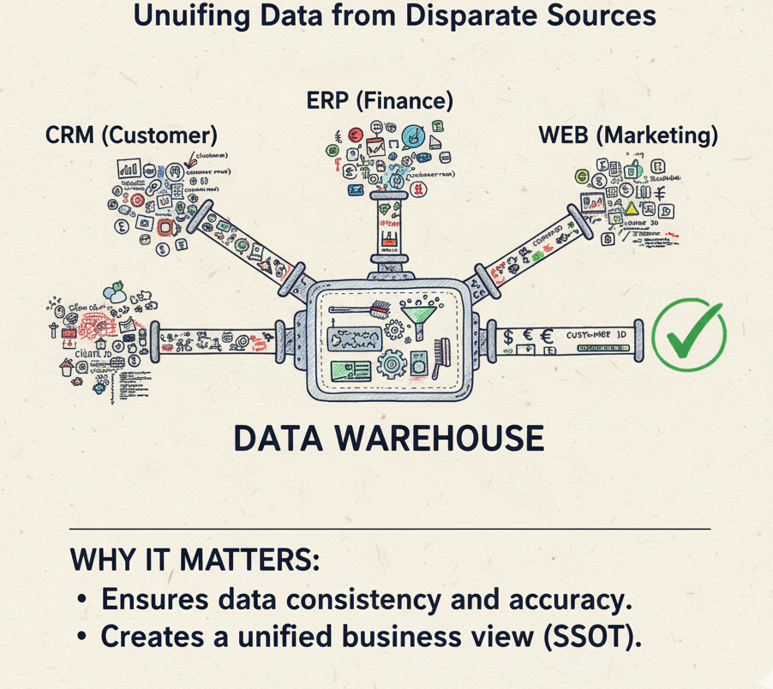
Characteristic 2: Integrated
Integrated
Consolidates Disparate Data: Data is pulled from many different source systems.
Achieves Consistency: The data warehouse cleans, scrubs, and transforms this data into a single, common format.
Resolves Conflicts: Ensures "customer_ID" and "client_num" are treated as the same thing.
Why it Matters: Creates a unified view of the business and is essential for building the "Single Source of Truth."

Slide 11
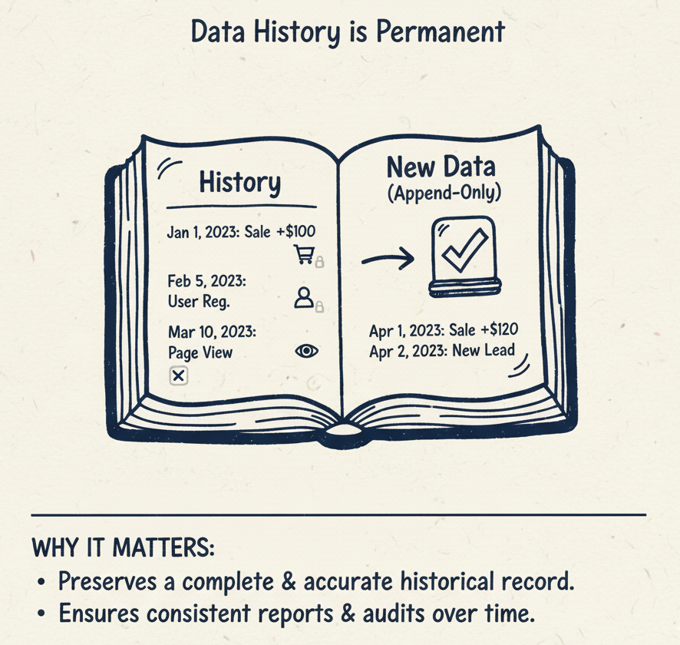
Characteristic 3: Nonvolatile
Nonvolatile
"Volatile" means changing. "Nonvolatile" means stable and unchanging.
Once data is loaded into the warehouse, it is never overwritten, updated, or deleted.
New data is simply appended as a new record.
Why it Matters: Preserves a complete and accurate historical record. It ensures that reports run today will match reports run a year from now for the same period.

Slide 12
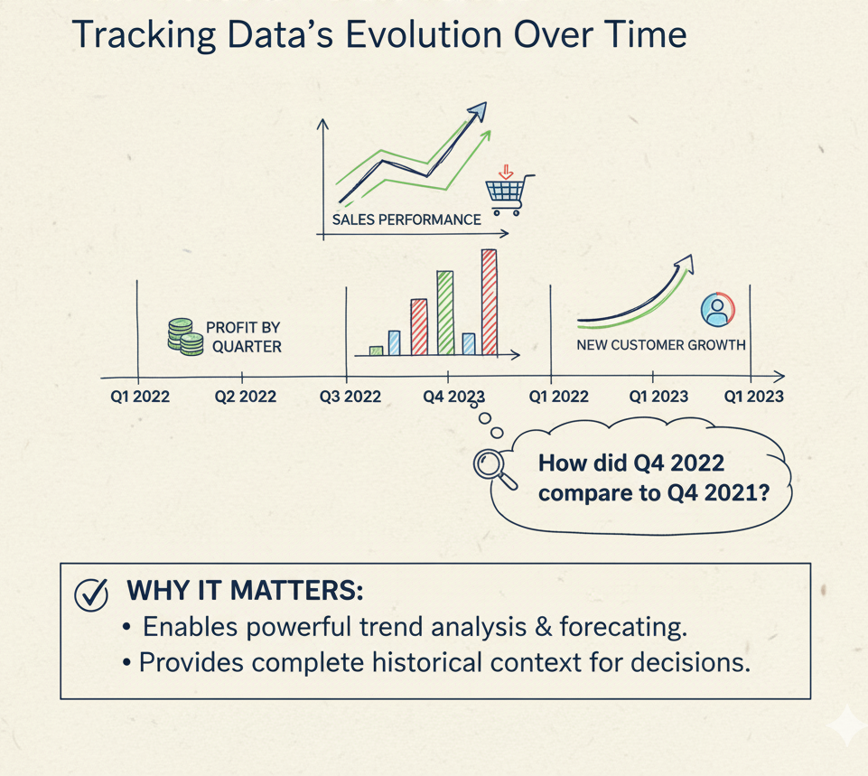
Characteristic 4: Time-Variant
Time-Variant
All data in the warehouse is associated with a specific point in time (e.g., a timestamp, date, or quarter).
This allows for analysis of changes over time.
Enables Key Questions:
"How did sales this quarter compare to last year's quarter?"
"What did our customer base look like five years ago?“
Why it Matters: This is what makes trend analysis, forecasting, and historical comparisons possible.

Slide 13
Summary
Subject-Oriented: Focused on business subjects (Customers, Sales).
Integrated: Data is cleaned and unified into one consistent format.
Nonvolatile: Data is stable and never changed, only added to.
Time-Variant: All data is tied to a specific time, enabling trend analysis.

Slide 14
Data Flow in a Warehouse System

Slide 15
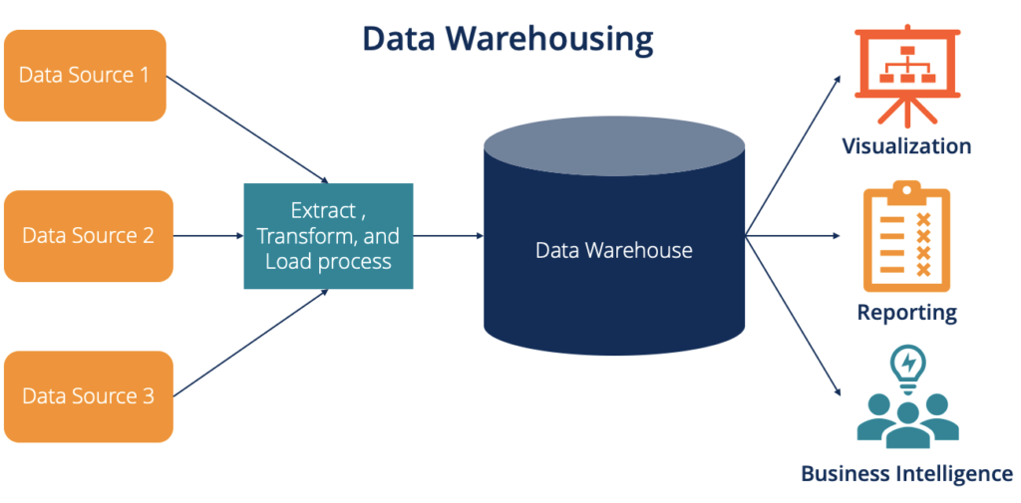
Understanding How Data moves from Source to Insights!
A Data Warehouse (DW) is a centralized repository for integrated data from multiple sources.
It supports business intelligence (BI), reporting, and analytics.
Data flow represents the journey of data - from raw sources to actionable insights.
Key Components in Data Flow
Source Systems – Databases, flat files, ERP/CRM systems, APIs.
Staging Area – Temporary storage for raw data before transformation.
ETL Process – Extract, Transform, Load data into warehouse.
Data Warehouse Storage – Centralized repository (fact and dimension tables).
Data Marts – Subsets of warehouse data for specific business functions.
BI / Reporting Layer – Dashboards, visualizations, and queries.

Slide 16
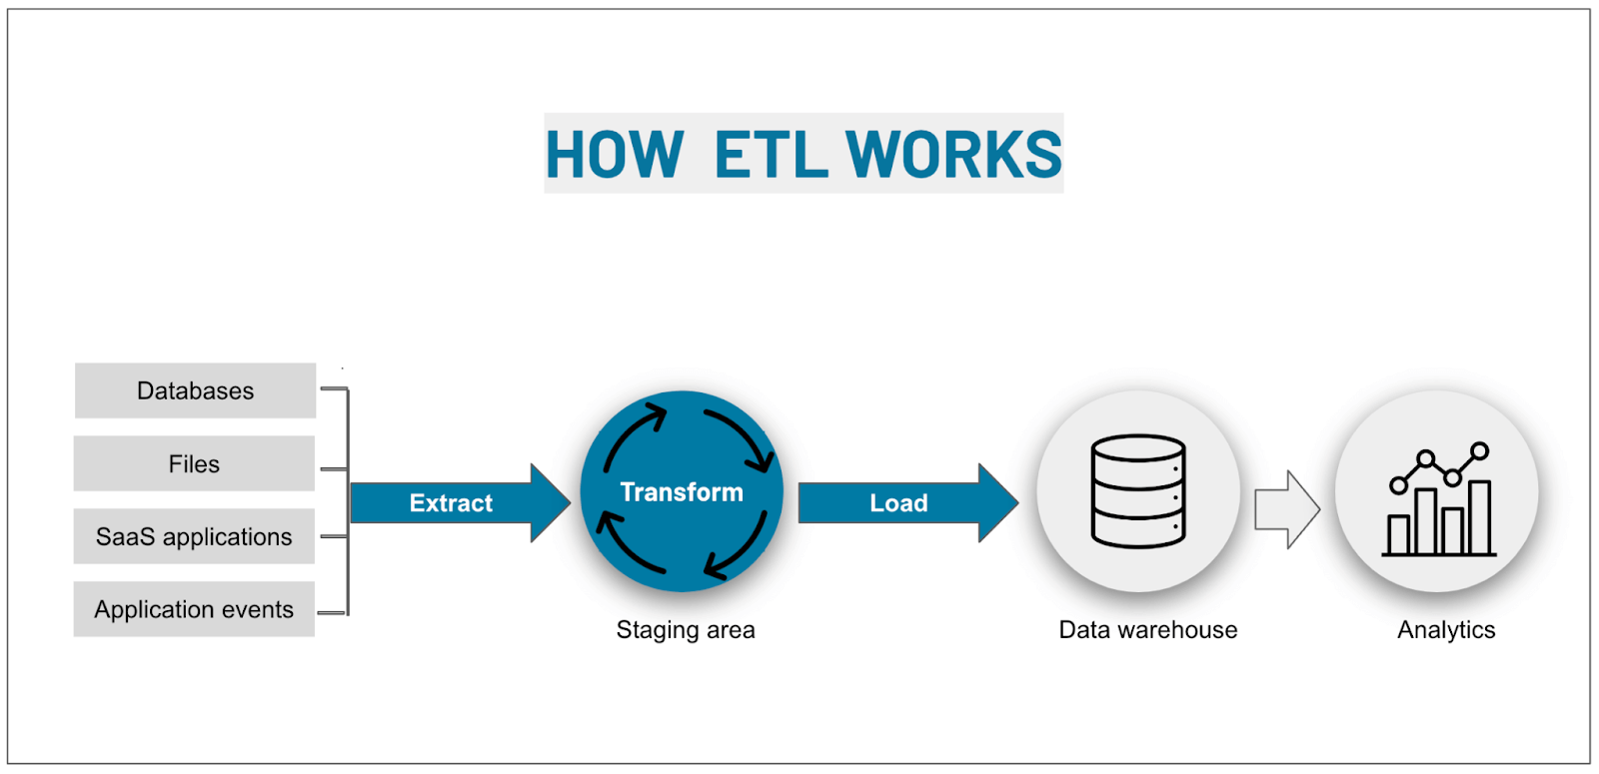
Overview of Data Flow Process
Data flow in a warehouse typically follows these stages:
Data Extraction
Data Transformation
Data Loading
Data Analysis and Reporting
The data flow process ensures that raw, unstructured data from multiple systems is transformed into clean, integrated, and analytics-ready information.
Each step - from extraction to reporting - plays a crucial role in enabling accurate, timely, and data-driven decision-making across the organization.
Source Systems → Staging Area → ETL Process → Data Warehouse → Data Marts → BI Tools/Reports

Slide 17
Stages of Data Flow
Stage 1 – Data Extraction
Stage 3 – Data Loading
Data is pulled from various operational sources such as:
Relational Databases (OLTP systems)
Flat files / CSV
Web APIs
Legacy systems
Types of extraction:
Full Extraction: All data every time.
Incremental Extraction: Only new/changed data (using CDC).
Tools used: Talend, Informatica, Apache NiFi.
Transformed data is loaded into the warehouse.
Loading can be:
Initial Load: First-time full data load.
Incremental Load: Periodic updates (daily/weekly).
Data is organized into schemas (Star / Snowflake).
Fact and dimension tables are populated.
Stage 4 – Data Storage and Management
Centralized storage area for historical and analytical data.
Data is stored in dimensional models:
Fact Tables: Quantitative data (sales, revenue, etc.)
Dimension Tables: Descriptive attributes (time, region, product).
Metadata repository tracks data lineage and definitions.
Stage 2 – Data Transformation
Raw data is cleaned and converted into a consistent format.
Common transformations include:
Data validation and cleaning
Removing duplicates and errors
Data type conversions
Deriving new attributes
Applying business rules
Ensures data quality and integrity before loading.

Slide 18
Stages of Data Flow
Stage 5 – Data Access and Analysis
Data Flow Tools and Technologies
Data is now available for querying and reporting.
Tools used: Power BI, Tableau, Looker, Excel.
Data analysis operations:
Slice and Dice
Drill Down / Roll Up
Pivoting
Supports decision-making and strategic planning.
Layer | Example Tools
Extraction | Talend, Informatica, NiFi
Transformation | SQL, PySpark, dbt
Loading | Airflow, AWS Glue, Azure Data Factory
Storage | Snowflake, Redshift, BigQuery
Visualization | Power BI, Tableau
Real-Time Data Warehousing
Modern systems use streaming data pipelines.
Tools: Kafka, Apache Spark, AWS Glue, Snowflake Streams.
Enables near real-time analytics for business decisions.

Slide 19
Benefits and Challenges of Efficient Data Flow
Benefits
Improved Data Quality-Ensures clean, consistent, and accurate data for reliable analysis.
Faster Decision-Making-Provides timely insights that support quick business actions.
Enhanced System Performance-Optimizes data processing and reduces latency in data movement.
Scalability and Flexibility-Easily adapts to growing data volumes and new sources.
Consistency Across Systems-Maintains a single, unified version of truth across all platforms.
Cost Efficiency-Reduces resource wastage through automation and optimized data flow.
Better Compliance and Governance-Supports secure, traceable, and regulation-compliant data handling.
Challenges
Data Integration Complexity-Combining data from multiple, diverse sources is technically challenging.
High Data Volume and Velocity-Large and fast-moving data can strain processing systems.
Data Quality Issues-Inaccurate or incomplete data can disrupt analytics.
Performance Bottlenecks-Slow ETL jobs or unoptimized queries affect system efficiency.
Security and Privacy Risks-Sensitive data may be exposed during transfer or processing.
Maintenance and Monitoring Overhead-Pipelines need constant supervision and performance tuning.
High Infrastructure Cost-Implementing robust data flow systems can be expensive.

Slide 20
Data Warehouse Architecture

Slide 21
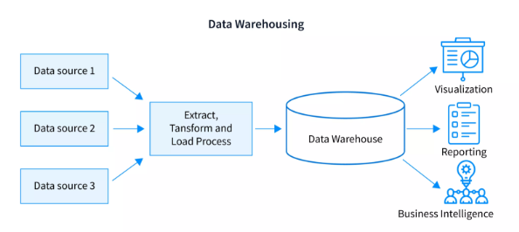
What is data warehouse architecture?
A data warehouse is a data management system that stores current and historical data from multiple sources in a business-friendly manner for insights and reporting.
Data warehouse architecture refers to the framework that governs how a data warehouse is organized, structured and implemented, including components and processes.
Data warehouse architecture refers to :
Subject-oriented — Data is organized and structured around
specific business topics or themes, such as sales,
marketing or distribution data
Integrated — The data warehouse integrates data from
multiple sources in a unified way
Time-variant — Data represents a historical snapshot, capturing
changes over time, allowing for trend analysis and
reporting on how data has evolved
Nonvolatile — Data in the warehouse is read-only; it will not be
changed or overwritten, keeping historical data intact
and reliable for analysis

Slide 22
Why a Data Warehouse Architecture?
Primary Goal: To enable organizations to quickly and easily analyze consolidated business data from all their operational systems (e.g., POS, CRM, Inventory).
Key Roles:
Crucial for Business Intelligence (BI), analytics, and reporting.
Prepares data for Machine Learning (ML) models.
Supports modern uses for unstructured data (images, text) and AI.
What it unlocks:
Analysis of large data volumes.
Ability to analyze trends over time (historical data).
Answers complex questions that transactional databases can't handle (e.g., "Total revenue by salesperson, by month, for each product category").

Slide 23
Tiers in Data Warehouse Architecture
Data warehouse architectures vary in complexity. The "tiers" refer to the separation of components.
Single-Tier: The simplest form. The data warehouse is a single, centralized repository for both data and analysis.
Two-Tier: Separates the source systems from the data warehouse. Offers better scalability and performance than a single-tier model.
Three-Tier: The most common and complex architecture. Provides the highest performance and scalability.
This model separates the system into three distinct logical layers.
Tier 1: Bottom Tier (Data): Consists of the data sources, data ingestion/extraction tools, and the data warehouse database itself (where data is stored).
Tier 2: Middle Tier (Analysis):
The Online Analytical Processing (OLAP) server.
This is the "engine" that transforms the data and makes it available for complex querying and analysis.
Tier 3: Top Tier (Presentation)
The front-end client layer.
This is what the user sees: BI tools, dashboards, reporting, and analysis tools.

Slide 24
The Conceptual Layers (Data Flow)
This describes the journey of the data from raw to ready.
Source Layer: The foundation. The entry point for all raw data from systems like CRM, ERP, POS, etc.
2. Staging Layer: A temporary buffer where data is stored before going into the warehouse. This is where data is consolidated, cleaned, and transformed.
3. Warehouse Layer: The "single source of truth." This is where the processed, cleaned, and structured data is stored for long-term use and analysis.
4. Consumption Layer: Makes the data accessible to business users. This layer includes BI tools, dashboards, and APIs that provide a user-friendly interface.

Slide 25
Top Down and Bottom Up Approach
Two pioneers, Bill Inmon and Ralph Kimball, proposed different (and competing) approaches to building a data warehouse.
1. The Inmon Approach (Top-Down)
Start by building a single, centralized, enterprise-wide data warehouse. This is the "single source of truth."
Data is highly normalized (minimized redundancy) in the central warehouse.
Pull data from all sources into the central DW.
Clean and normalize all enterprise data.
Create smaller Data Marts (for specific departments) from the central warehouse.
2. Kimball Approach (Bottom-Up)
Start by building small, specialized databases (Data Marts) for individual departments (e.g., Sales, Marketing) to deliver value quickly.
Uses a dimensional model (Star Schema). Data is denormalized (accepts some redundancy for speed).
Build a Data Mart for the Sales team.
Build a Data Mart for the Marketing team.
The "Data Warehouse" becomes the combination of these integrated data marts.

Slide 26
Structuring the data warehouse
These schemas act as a blueprint for how data will be stored and managed, including definitions of terms and relationships and their arrangement. Enterprises use three types of schema to structure a data warehouse.
Star schema :A star schema is a multidimensional data model used to organize data in a database so that it’s easy to understand and analyze. Star schemas enable users to slice and dice the data however they see fit, typically by joining two or more fact tables and dimension tables together.
Snowflake schema: A snowflake schema is an extension of a star schema where dimension tables are broken down into subdimensions. This makes the data model more complex, but it can be easier for analysts to work with for certain data types.

Slide 27
Need for Data Warehousing in organizations

Slide 28
Why Do We Need a Data Warehouse?
Organizations generate large volumes of data across departments like sales, HR, marketing, and finance.
This data often exists in different formats and systems, making it difficult to analyze.
A Data Warehouse provides a centralized repository to integrate and organize data from multiple sources.
Ensures data consistency, supports historical trend analysis, and improves decision-making.
Also reduces the burden on day-to-day operational systems (OLTP).
How Data Warehousing Supports Organizations?
Enables accurate forecasting and strategic planning.
Improves Business Intelligence (BI) and reporting efficiency.
Helps track customer behavior and market trends effectively.
Ensures data reliability, accuracy, and governance.
Serves as a foundation for AI, Machine Learning, and Predictive Analytics.
Makes organizations more data-driven, efficient, and competitive.

Slide 29
Need 1: Creating a Single Source of Truth (SSOT)
This is the most fundamental need for a data warehouse.
The Problem:
The Marketing team says they generated 1,000 leads last month.
The Sales team says they only received 800 leads from Marketing.
Who is right?
The business can't move forward if it can't agree on basic facts.
The Data Warehouse Solution:
The DW pulls lead data from both Marketing and Sales systems.
It applies a standard, agreed-upon definition of what a "lead" is.
It creates a single, unified list of leads that everyone in the company can access.
Benefit: One version of the truth. Everyone from the CEO to a new analyst uses the same data, leading to trust and better, faster decisions.

Slide 30
Need 2: Powerful Business Intelligence (BI) & Reporting
Operational systems are terrible at answering complex analytical questions.
The Problem:
You want to ask: "What was the total profit from customers under the age of 30 in our Northern region who bought Product X after clicking on our summer marketing email?"
Trying to run this query on a live sales system would slow it down for everyone!
It would require manually combining data from 3-4 different systems.
The Data Warehouse Solution:
The DW has already integrated data from sales, customer, and marketing systems.
It is structured and optimized for these exact types of complex queries.
It serves as the powerful engine behind BI tools like Tableau, Power BI, and Looker.
Benefit: Fast, deep insights. Business users can explore data, create dashboards, and answer their own questions without needing an IT expert every time.

Slide 31
Need 3: Unlocking Historical Analysis & Forecasting
You can't plan for the future without understanding the past.
The Problem:
Your operational CRM system might only store customer addresses for the last 18 months.
You can't answer the question: "How has the lifetime value of our customers changed over the last 10 years?"
The Data Warehouse Solution:
Because a DW is time-variant, its primary goal is to accumulate historical data.
It stores a "long memory" of the organization.
Benefit: Predict the future. By analyzing long-term trends, you can:
Identify seasonal buying patterns.
Forecast future sales and inventory needs.
Predict which customers might be at risk of leaving (churn analysis).

Slide 32
Need 4: Enhancing Data Quality and Consistency
Decisions are only as good as the data they are based on. "Garbage in, garbage out."
The Problem:
Source systems are often full of "dirty data":
Typos: "Jhon Smith"
Missing Values: Blank phone numbers.
Inconsistent Formats: Dates like 10/24/2025, 24-Oct-25, 2025-10-24.
The Data Warehouse Solution:
Data isn't just dumped into the warehouse. It goes through a critical process called ETL (Extract, Transform, Load).
Extract: Pull data from the source systems.
Transform: Clean, validate, standardize, and apply business rules to the data.
Load: Load the clean, high-quality data into the warehouse.
Benefit: High-quality, trustworthy data. This builds confidence throughout the organization and prevents costly errors based on bad information.

Slide 33
Real-World Examples
Retail (Amazon, Walmart):
Use Case: Market Basket Analysis. They analyze your shopping cart data to see which products are frequently bought together.
Benefit: They can recommend products ("Customers who bought this also bought...") and optimize store layouts.
Finance (Banks, Credit Card Companies):
Use Case: Fraud Detection. They analyze your transaction history to spot unusual patterns that might indicate your card was stolen.
Benefit: Protects customers and reduces financial losses.
Healthcare (Hospitals):
Use Case: Patient Outcome Analysis. They integrate data from patient records, lab results, and treatments over many years.
Benefit: Helps doctors understand which treatments are most effective for certain diseases.

Slide 34
OLTP vs. OLAP

Slide 35
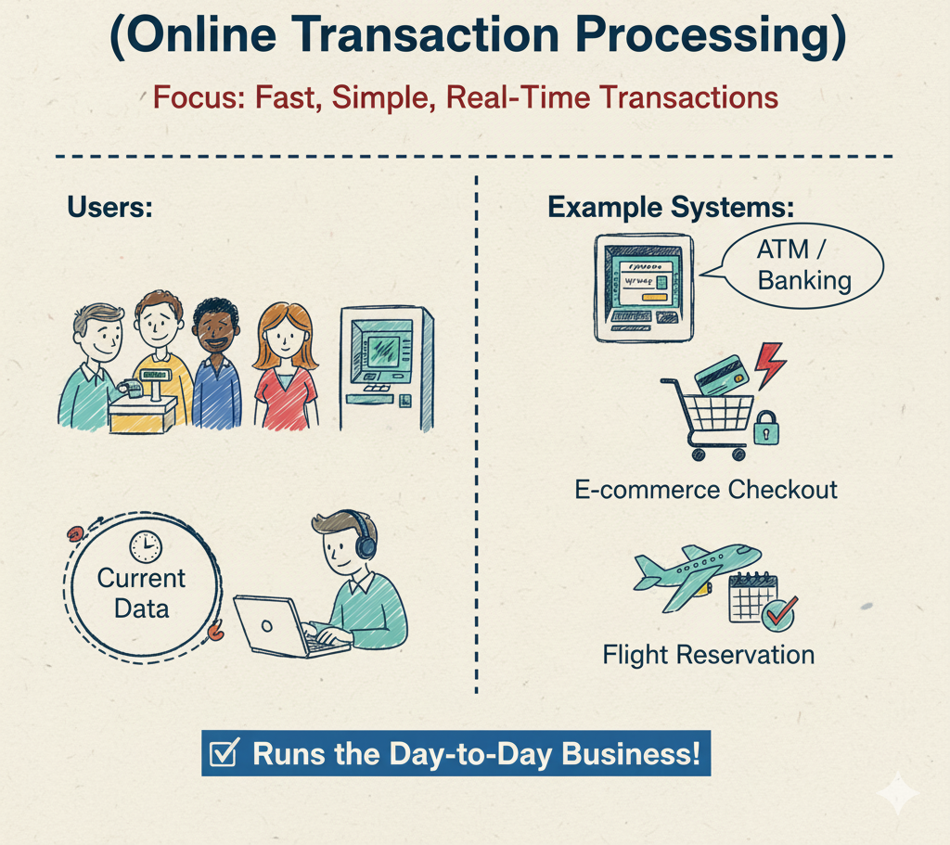
What is OLTP?
OLTP (Online Transaction Processing)
Purpose: To run the day-to-day business operations.
Focus: Fast, simple transactions (e.g., INSERT, UPDATE, DELETE).
Data: Current, real-time, detailed data.
Users: Front-line workers (e.g., cashiers, bank tellers, customer service).
Example Systems:
ATM / Banking System
E-commerce Checkout
Flight Reservation System

Slide 36
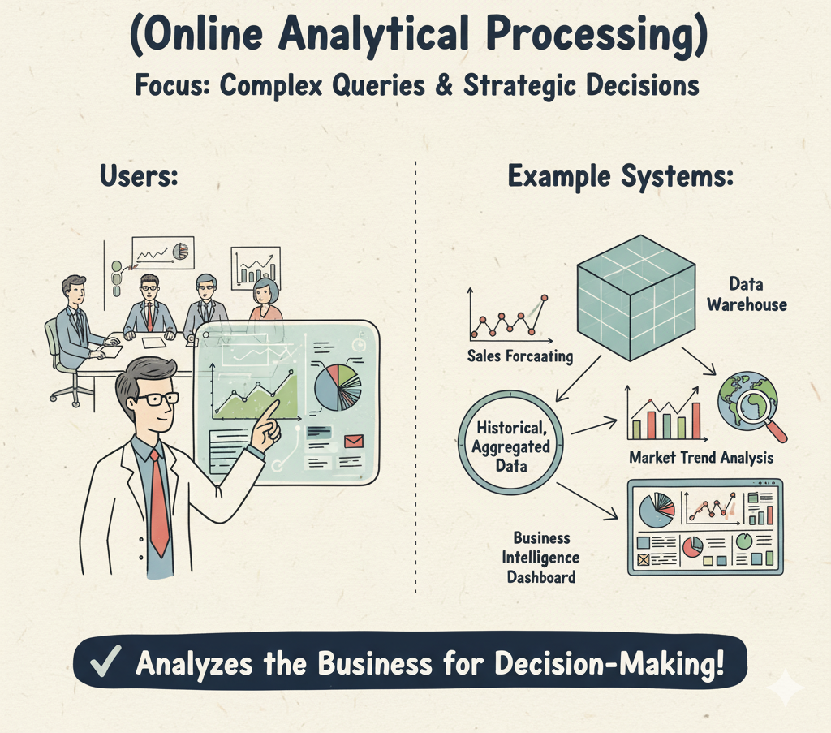
What is OLAP?
OLAP (Online Analytical Processing)
Purpose: To analyze the business for decision-making.
Focus: Complex queries and analysis (e.g., "What are the sales trends by region for the last 5 years?").
Data: Historical, aggregated, and summarized data.
Users: Business analysts, data scientists, executives.
Example Systems:
A Data Warehouse
Sales Forecasting Reports
Market Trend Analysis

Slide 37
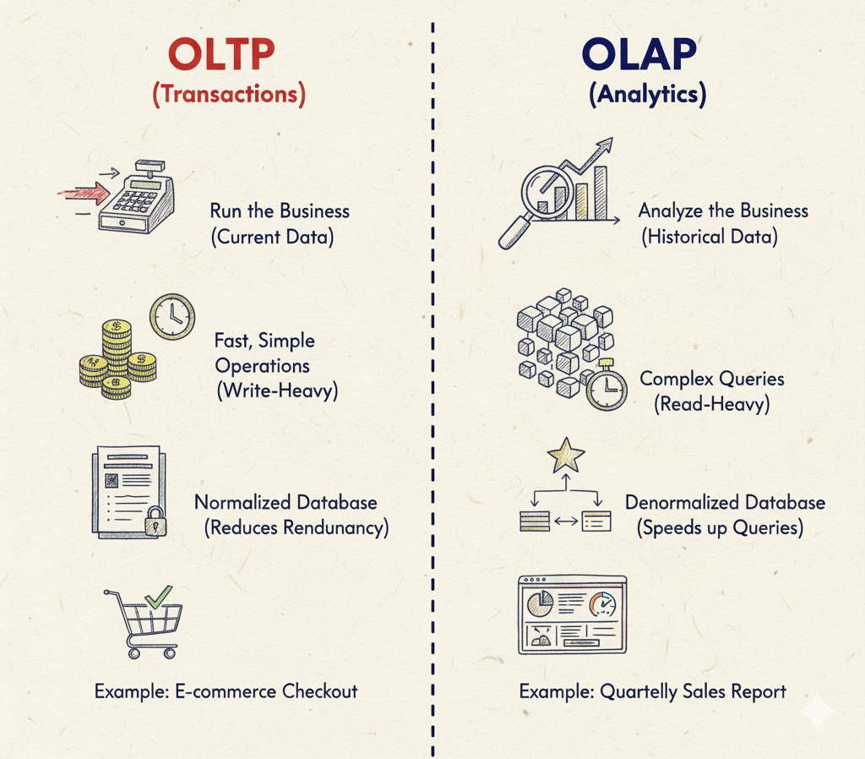
OLTP vs. OLAP
Feature | OLTP (Transactions) | OLAP (Analytics)
Primary Goal | Run the Business | Analyze the Business
Data | Current, Real-Time | Historical, Aggregated
Operations | Fast, Simple (Write-Heavy) | Complex Queries (Read-Heavy)
Database Design | Normalized (Reduces Redundancy) | Denormalized (Speeds up Queries)
Unit of Work | Small, Quick Transactions | Large, Complex Queries
Example | ATM Withdrawal | Quarterly Sales Report

Slide 38
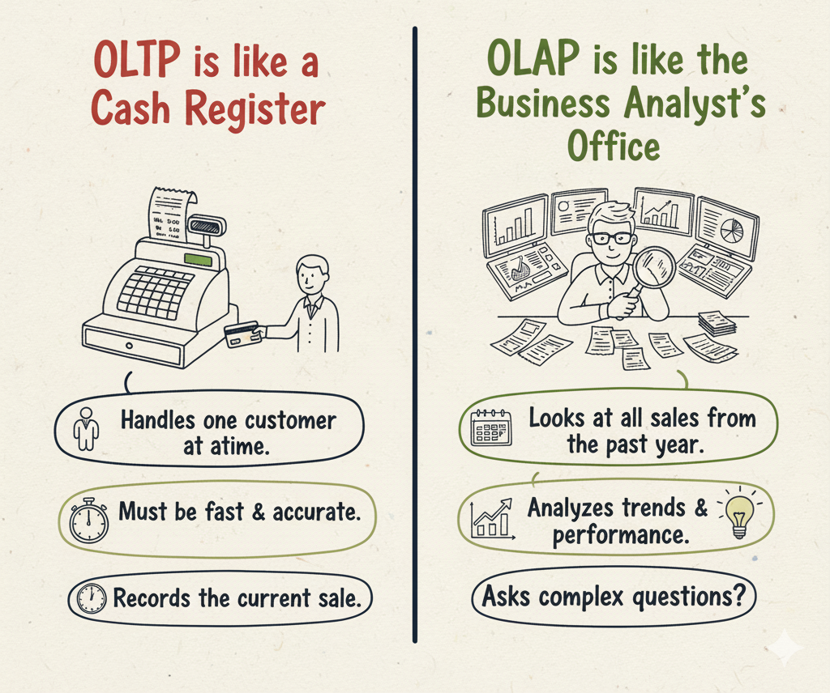
A Simple Analogy
OLTP is like a Cash Register:
Handles one customer at a time.
Must be fast and accurate.
Records the current sale.
OLAP is like the Business Analyst's Office:
Looks at all the sales receipts from the past year.
Analyzes trends and performance.
Asks complex questions ("What's our most popular item?").

Slide 39
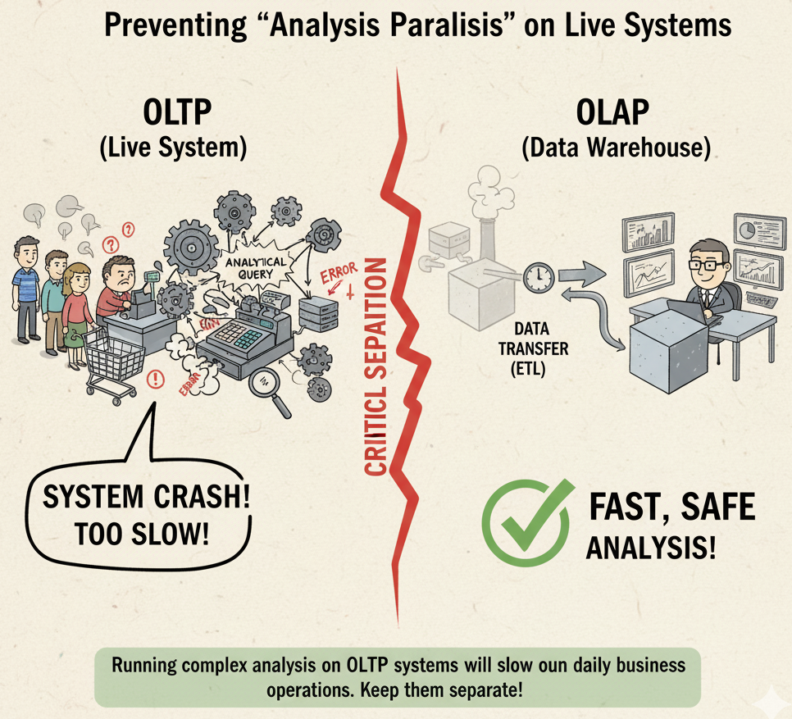
Why Keep Them Separate?
Why Can't We Just Analyze the OLTP System?
Performance:
Running a massive analytical query (OLAP) on your live transaction system (OLTP) would be like asking a cashier to stop working and count all the money in the vault.
It would grind your daily business to a halt.
Data Structure:
OLTP systems are not designed (normalized) for complex queries; they are designed for fast transaction speed.
Solution:
We regularly move data from OLTP systems (and other sources) into an OLAP system (the Data Warehouse), where it can be analyzed safely.

Slide 40
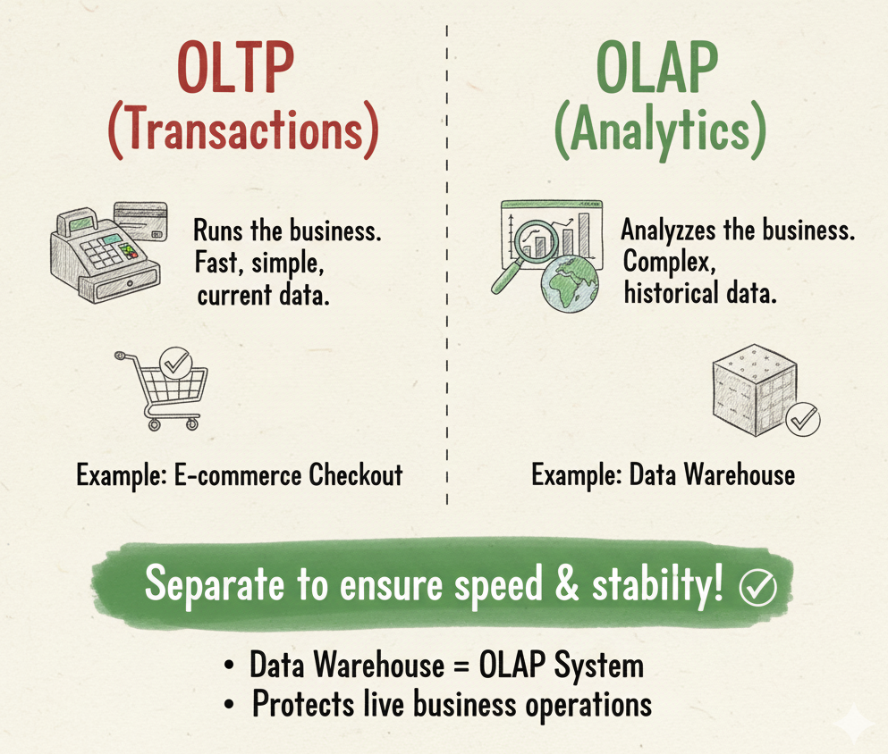
Summary
OLTP (Transactions): Runs the business. Fast, simple, current data.
OLAP (Analytics): Analyzes the business. Complex, historical data.
A Data Warehouse is an OLAP system.
They must be kept separate to ensure the speed and stability of daily business operations.

Slide 41
Top-Down vs. Bottom-Up Approaches

Slide 42
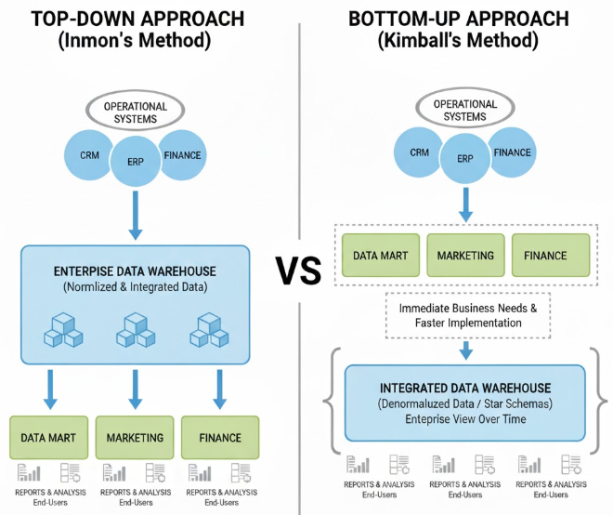
What is a Design Approach?
When building a data warehouse, the fundamental question is: Where do we begin?
Do we build the entire city first, then the houses? Or build the houses first and then connect them to form a city? This choice defines the entire project's strategy, timeline, and cost.
Top-Down Approach: Build a single, centralized enterprise data warehouse first.
Bottom-Up Approach: Build individual, departmental data marts first and integrate them over time.

Slide 43
The Top-Down Approach (Inmon Model)
Championed by Bill Inmon, this model advocates for a holistic, enterprise-wide strategy from the start.
Analogy: Building a central city reservoir (the Data Warehouse) before laying pipes to individual neighborhoods (Data Marts).
Philosophy: Start with the big picture. Create a single, centralized, and normalized Enterprise Data Warehouse (EDW) as the ultimate source of truth.
Data Marts: Departmental data marts are created after the EDW is built and are completely dependent on it for data.
Focus: High data integrity, consistency, and a robust, long-term solution.
Top-Down Architecture Overview: The data flows from various sources, is integrated in the central EDW, and then distributed to specific data marts for user analysis.
Step 1: Data is extracted from various transactional source systems (CRM, ERP, etc.).
Step 2: It goes through an ETL (Extract, Transform, Load) process.
Step 3: Data is loaded into a large, centralized, and highly normalized Enterprise Data Warehouse. This is the core of the system.
Step 4: Smaller, often subject-specific Data Marts are created using data from the EDW.
Step 5: Business users perform analysis using BI tools connected to the data marts.

Slide 44
Pros and Cons of the Top-Down Approach
Pros:
Single Source of Truth: Creates a highly consistent and reliable data foundation.
Strong Data Integration: By design, it avoids data redundancy and inconsistencies.
Resilient to Change: A robust model is less likely to break when business rules or source systems change.
Scalable: Easier to manage and expand once the foundation is built.
Cons:
High Initial Cost & Time: Requires significant upfront investment in time, money, and resources.
Slow Time-to-Value: Business users may wait months or even years before they can use the system.
High Risk: The long project duration and complexity increase the risk of failure.
Inflexible: Difficult to change the core model once implementation has started.

Slide 45
The Bottom-Up Approach (Kimball Model)
Championed by Ralph Kimball, this model focuses on delivering business value quickly through an iterative process.
Analogy: Building individual houses (Data Marts) with compatible plumbing and electricals, then connecting them with roads (the Data Bus) to form a city.
Philosophy: Start small and deliver value fast. Build business process-centric Data Marts first.
Data Warehouse: The enterprise data warehouse is a logical combination of these individual data marts, connected through shared, conformed dimensions (e.g., 'Date', 'Customer').
Focus: Business requirements, speed of delivery, and ease of use for analytics.
Bottom-Up Architecture Overview: This approach builds independent data marts that can be used immediately and are later integrated.
Step 1: Identify a specific, high-priority business process (e.g., sales analysis).
Step 2: Data is extracted from relevant sources via an ETL process.
Step 3: A Dimensional Data Mart (using a Star Schema) is created to serve that specific business need.
Step 4: Business users get immediate access.
Step 5: The process is repeated for other departments, using conformed dimensions to ensure the marts can be logically linked. This integration is known as the Data Warehouse Bus Architecture.

Slide 46
Pros and Cons of the Bottom-Up Approach
Pros
Fast Time-to-Value: Delivers actionable insights to business users in weeks or months, not years.
Lower Initial Cost & Risk: Projects are smaller, more manageable, and funded incrementally.
Agile and Flexible: The iterative nature makes it easier to adapt to changing business requirements.
Business-Driven: Each mart is built to solve a specific, real-world business problem.
Cons
Risk of Data Silos: Without strong governance, it can become a collection of disconnected data marts.
Integration Challenges: Ensuring dimensions are "conformed" across teams can be difficult and may require rework.
Not a True "Single Source" Initially: The holistic, enterprise-wide view is built over time, not from the start.

Slide 47
Comparison Table
Feature | Top-Down (Inmon) | Bottom-Up (Kimball)
Starting Point | Starts with an Enterprise Data Warehouse (EDW) that integrates all enterprise data. | Starts with departmental Data Marts focused on specific business areas.
Core Philosophy | Create a single version of the truth across the organization. | Deliver quick business value through smaller, focused implementations.
Data Model Type | Normalized (3NF) – focuses on minimizing redundancy and ensuring data integrity. | Dimensional (Star Schema / Snowflake) – designed for ease of reporting and analysis.
Integration Approach | Data is first integrated centrally in the EDW, then shared with departments. | Data marts are created first and then integrated to form a data warehouse.
Implementation Time | Long-term, often takes years to fully implement. | Faster and iterative, delivers results within months.
Initial Cost | High due to heavy upfront planning, modeling, and infrastructure. | Lower as it starts small and scales as needed.
Data Loading (ETL) | Complex ETL process with strong data validation and cleansing. | Simpler ETL focused on transforming data for reporting needs.
Reporting Performance | Slower for direct reporting due to normalization. | Faster queries due to pre-aggregated, dimensional design.
Best For | Large enterprises focused on data governance and accuracy. | Organizations needing quick insights and business agility.

